Slide 1

Property 348 Group Project
Matthew De Jager – 20822219
Emmanuel Jabiro – 19753284
Tendai Musendo – 20941714
RG Van Zyl – 19799667
Cameron Shepherd - 20887671

Slide 2
Table of contents
Section 1: Background (The investments strategy & the properties considered)
Section 2: Analysis & Recommendation
Section 3: Capital gains tax calculations
Section 4: Valuations
Section 5: Conclusion
Appendices

Slide 3
Section 1 - Background
Investment Strategy:
The investment opportunities presented in this report represent the initial strategy of investing in commercial and residential property.
The investor stands to generate monthly cash inflow in the form of rent income and to achieve capital appreciation of both properties.
The Investor has a long-term foreseeable investment horizon and see’s to make back their capital investment in 20 years.
Equity:
By obtaining a loan of R5 264 000 (7 520 000* 70%), the initial owners equity in this property portfolio amounts to R2 256 000
Required rates of return:
6.5% p.a (desired cushion of 250bp above current inflation and investor does not have a confident outlook on equity & bond market)

Slide 4

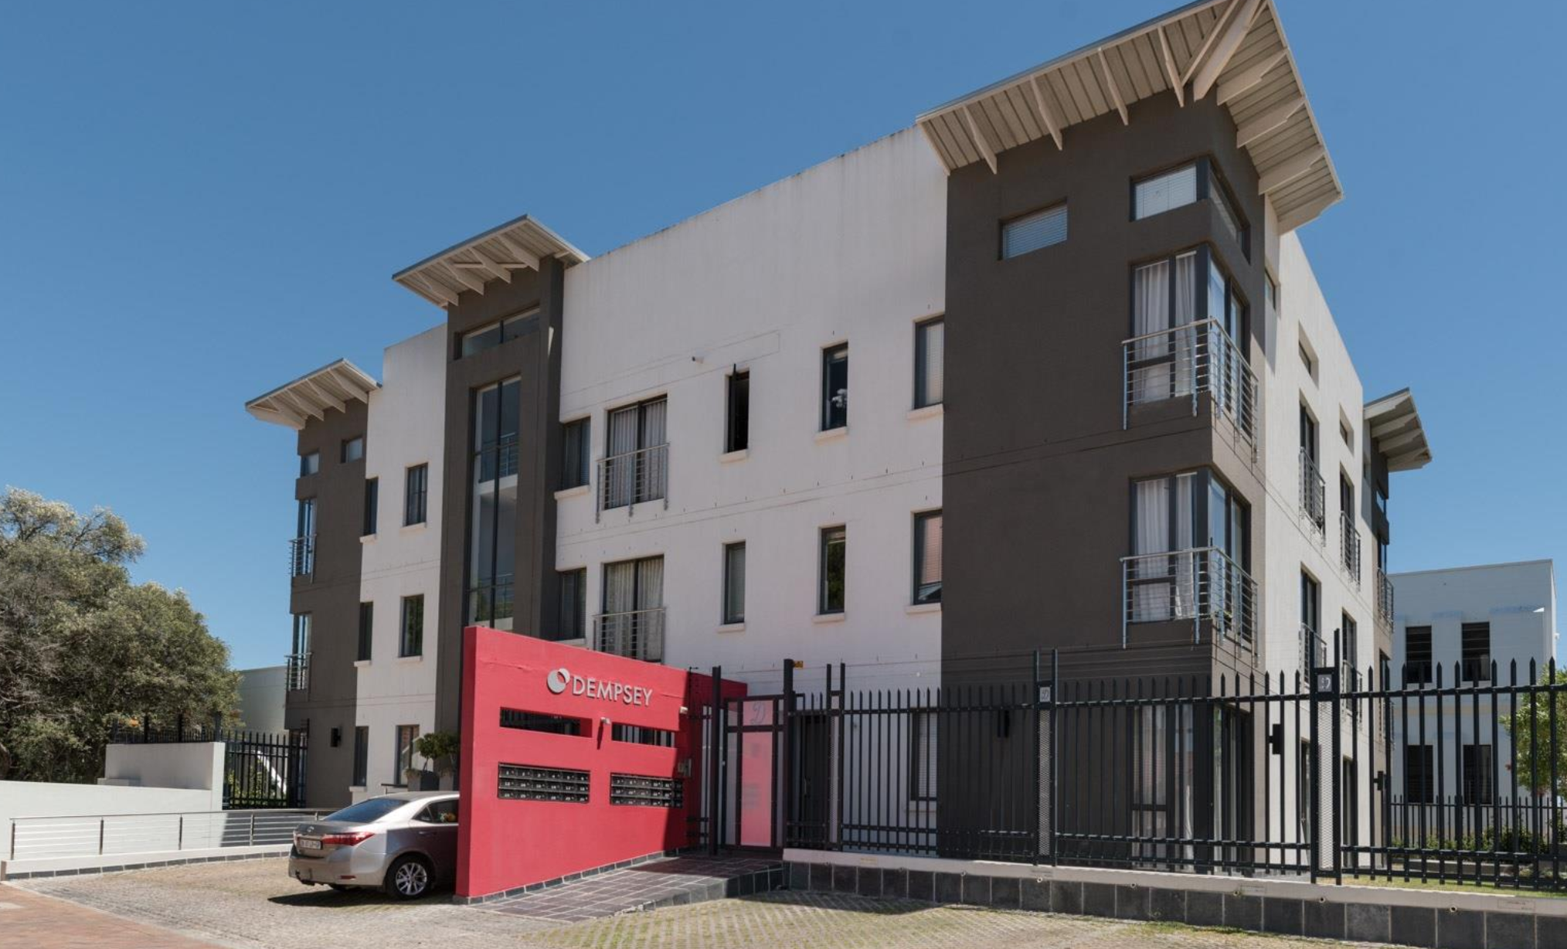
Potential Property: Residential
R1 895 000| 1 Bedroom Bachelor Apartment | Dempsey Building
Stellenbosch Central
"Semi furnished exclusive bachelor unit, in upmarket Dempsey in the heart of campus with great communal areas and basement parking, for sale" (Property24)
Specifications
Floor Space 76 m²
External features
1 Parking spots
West-facing
Garden
Security
Guard House
Electric Gate
Electric fencing
Source: Property24 (Refer to appendix for link to property)

Slide 5

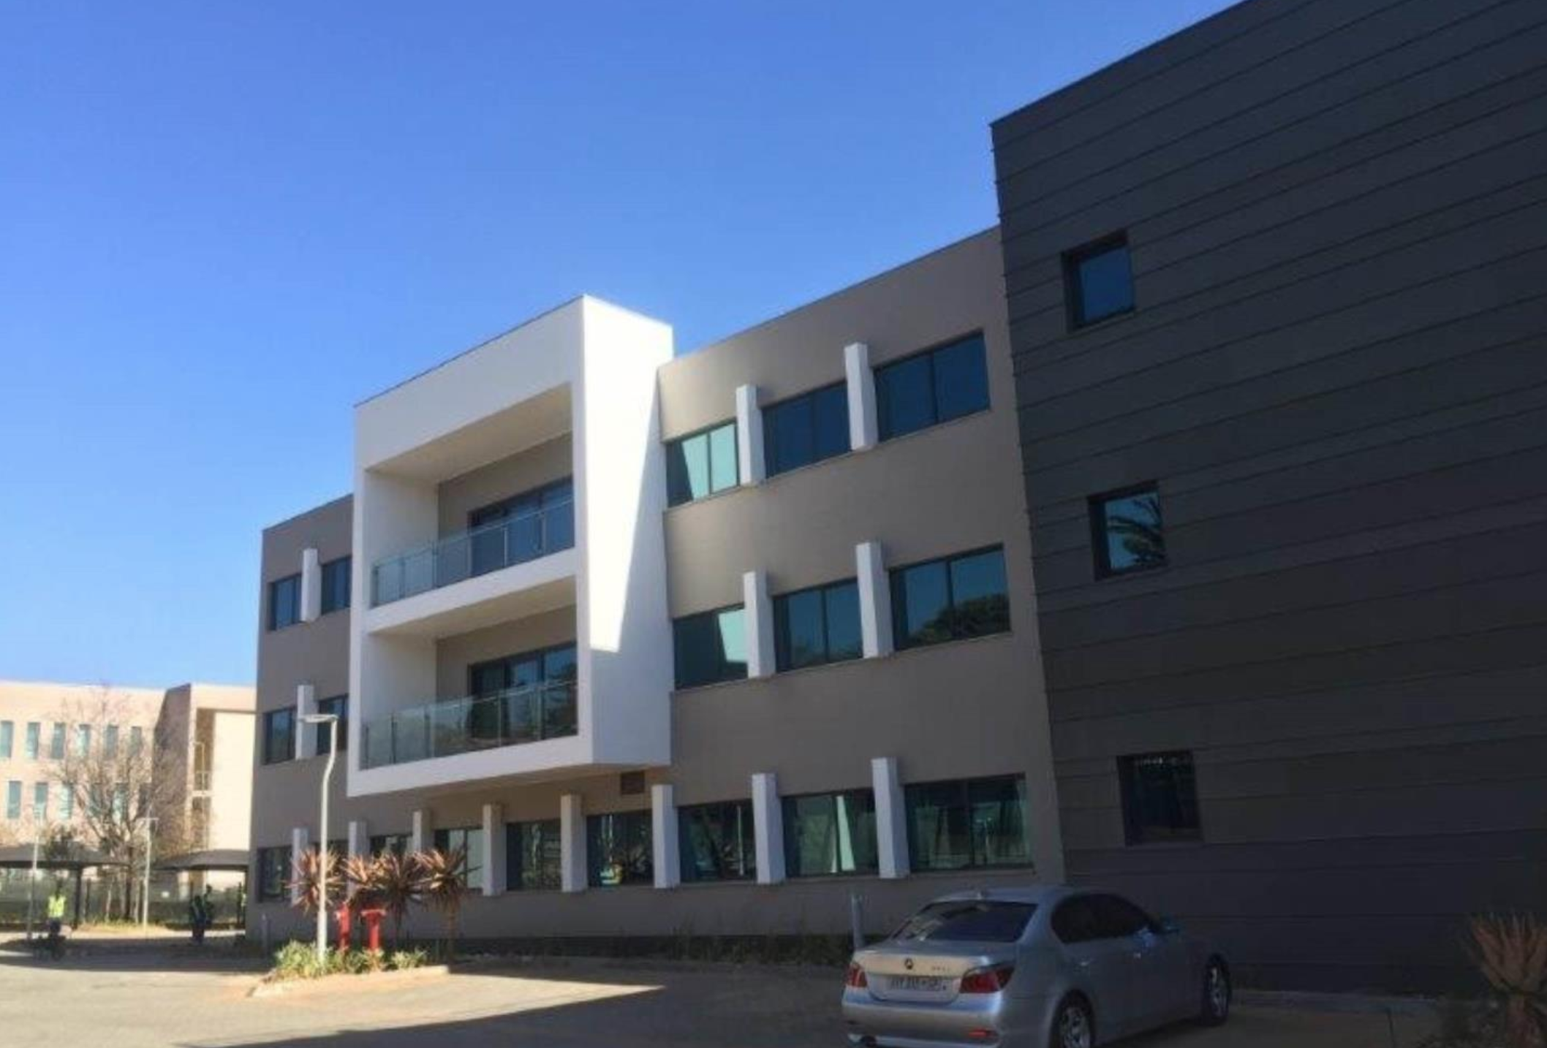
Potential Property: Commercial
R5 670 000 | Office Space| Sandton
Sandton, Johannesburg
“If you’re looking for office space in Sandton, you couldn’t chose a better location. ” (Flexible Workspace Business Centers)​
Specifications
Floor Space 300 m²
External features
28 Parking spots
Walking distance to the JSE
Access to Gautrain
Security
Guard House
Electric Gate
Source: Flexible Work Space Centres (Refer to appendix for link to property)

Slide 6
Commercial property
Gross Scheduled Income is calculated using the mean rental for Grade A+ offices in the Sandton CBD (R222,36 p/m^{2,} as taken from the Rode Report) and adjusted to R200 p/m², due to numerous factors like the building being situated just outside the Sandton CBD.
Year on year Growth Rate is 6%, as taken from SAPOA Cap & Discount Rate report, for a non CBD Prime Office.
Vacancy rate: 11% (SAPOA, 2019.)
Operating Expenses: R57.16 per square-meter (SAPOA, 2019.)
Gross Scheduled Income: R200 per square meter (as per similar property's in the vicinity of this office block.)
Annual operating expenses: 33.8% of gross income
Capitalisation rate: 9% (Rode Report, 2018.)

Slide 7
Commercial Property
Amortization Schedule
*Loan- to- value of 70%
Tax Calculation
*Annual W&T allowance = 5%
*Building value = R4 000 000

Slide 8
Commercial Property
Cash Flow Schedule
 | Year 1 | Year 2 | Year 3 | Year 4 | Year 5 | Year 6 | Year 7 | Year 8
Net Operating Income | R 397 440,00 | R 421 286,40 | R 446 563,58 | R 473 357,40 | R 501 758,84 | R 531 864,37 | R 563 776,24 | R 587 602,81
Less annual installment | R (578 227,45) | R (578 227,45) | R (578 227,45) | R (578 227,45) | R (578 227,45) | R (578 227,45) | R (578 227,45) | R (578 227,45)
Cash Flow before tax | R (180 787,45) | R (156 941,05) | R (131 663,87) | R (104 870,05) | R (76 468,61) | R (46 363,08) | R (14 451,21) | R 9 375,36
Less Tax | R (72 314,20) | R (84 882,79) | R (98 293,87) | R (112 604,63) | R (127 876,15) | R (144 173,75) | R (161 567,23) | R (180 131,18)
Cash Flow after tax | R (253 101,65) | R (241 823,84) | R (229 957,74) | R (217 474,68) | R (204 344,76) | R (190 536,83) | R (176 018,44) | R (170 755,82)
Equity Build up | R 280 552,45 | R 301 593,88 | R 324 213,42 | R 348 529,43 | R 474 669,13 | R 402 769,32 | R 432 977,02 | R 465 450,29
Appreciation | R 190 200,00 | R 190 200,00 | R 190 200,00 | R 190 200,00 | R 190 200,00 | R 190 200,00 | R 190 200,00 | R 190 200,00
Equity Income | R 470 752,45 | R 491 793,88 | R 514 413,42 | R 538 729,43 | R 664 869,13 | R 592 969,32 | R 623 177,02 | R 655 650,29
Value at end of year | R 4 240 000,00 | R 4 494 400,00 | R 4 764 064,00 | R 5 049 907,84 | R 5 352 902,31 | R 5 674 076,45 | R 6 014 521,04 | R 6 375 392,30
Mortgage balance end of year | R 3 688 447,55 | R 3 386 853,67 | R 3 062 640,25 | R 2 714 110,82 | R 2 339 441,69 | R 1 936 672,37 | R 1 503 695,34 | R 1 038 245,06
Equity end of year | R 551 552,45 | R 1 107 546,33 | R 1 701 423,75 | R 2 335 797,02 | R 3 013 460,62 | R 3 737 404,08 | R 4 510 825,70 | R 5 337 147,24
 | Year 8
*Average ROE | 21,88%

Slide 9
Commercial property
The Net Operating Income produced by the commercial property is enough to cover all costs pertaining to the property.
Average Return On Equity of 21,88% at the end of the 8th year, when it is sold.
The property is situated within Africa’s richest square mile (Sandton), which adds to its desirability even more, as all services such as; Banks, shops and restaurants are all within a small radius.
The profitable aspects highlighted within the ROE of the property, paired with the recent prosperity of the location lead us to believe that this is a viable and profitable investment opportunity for the investor, given her strategy.

Slide 10
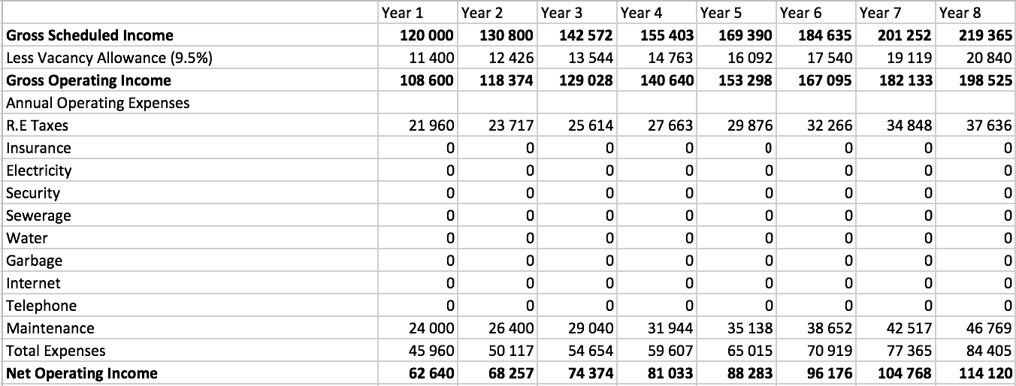

Residential property
Net Operating Income
*due to the apartment being a sectional title agreement, all the expenses are covered by the tenant
*Vacancy rate: 9.5% (SAPOA, 2019.)

Slide 11
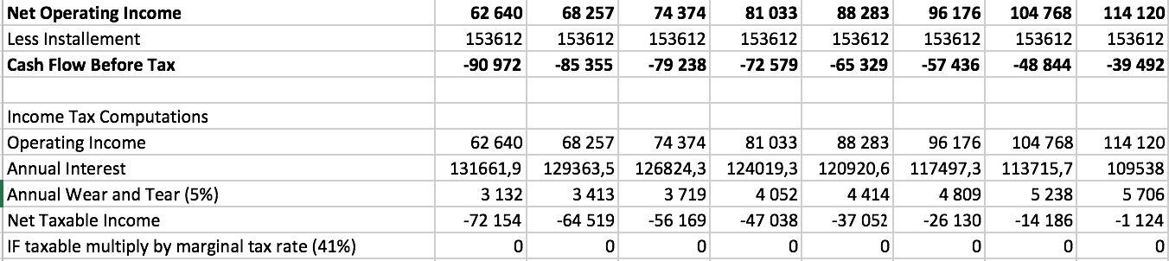
Residential property
Tax Calculations
*Tax loss for forecasted 8-year period
*Profitable over the entire investment horizon

Slide 12
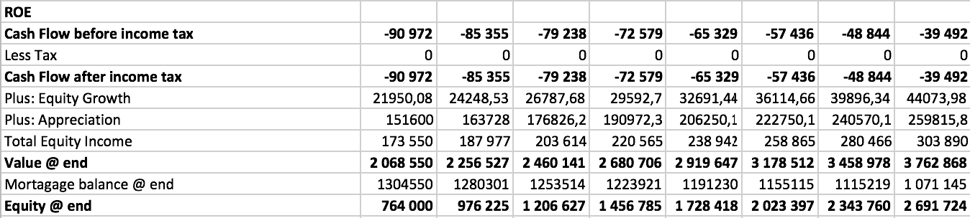
Residential property
Cash Flow Schedule
*Avg Roe Yr 8 = 27.29%

Slide 13
Residential property
The Stellenbosch real estate market has experienced significant growth in the past few years and despite volatile economic conditions, the market outlook bodes well for further capital appreciation.
Although initial costs are high, the equity-build forecast over the 8-year period provides the necessary equity value.
The investment is in line with the investors strategy and proves profitable (27.29% AVG ROE) in the 8- year period forecasted.

Slide 14
Section 3 – Capital Gains Tax
Residential building |  |  |  | Office building
Purchase price |  | R1,895,000.00 |  | Purchase price |  | R5,670,000.00
Cap rate(SAPOA) |  | 8.36% |  | Cap rate(SAPOA) |  | 9.20%
Net Operating Income at year 8 |  | R114,120.00 |  | Net Operating Income at year 8 |  | R597,602.81
Base cost | Sale Price | 114120/0.0836 |  | Base cost | Sale Price | 597602.81/0.092
1 895 000+0.07(1 365 072) = 1 990 555 |  | R 1,365,072.00 |  | 5670000+0.07(6495682.72)= 6124698 |  | R6,495,682.72
3.2.1 | Proceeds | 1365072 |  | Proceeds |  | 6495683
 | Less: Base cost | 1990555 |  | Less: Base cost |  | 6124698
 | Capital loss | -625483 |  | Capital gain |  | 370985
 | Less:Annual exclusion | -40000 |  | Less:Annual exclusion |  | 40000
 |  |  |  | Aggregate capital gain |  | 330985
 | No capital gain tax payable due to capital loss |  |  | Inclusion rate (40%) | 330985 x 0.40 | 132394
3.2.2 | Capital loss | -625483 |  | CGT payable (41%) | 132394 x 0.41 | R54,282.00
 | Less: Annual exclusion | -40000
 | Aggregate capital loss | -665483
 | Less: Primary residence exclusion | -2000000
 | No capital gain tax payable due to capital loss
3.2.3 | Capital loss | -312742
 | Less: Annual exclusion | -40000
 | Aggregate capital loss | -352742
 | Less: Primary residence exclusion | -1000000
 | No capital gain tax payable due to capital loss
3.2.4 | Proceeds | 1365072 |  | Proceeds |  | 6495683
 | Less: Base cost | 1990555 |  | Less: Base cost |  | 6124698
 | Capital loss | -625483 |  | Capital gain |  | 370985
 | Less:Annual exclusion | 0 |  | Less:Annual exclusion |  | 0
 |  | -625483 |  | Aggregate capital gain |  | 370985
 |  |  |  | Inclusion rate (80%) | 370985 x 0.80 | 296788
 | No capital gain tax payable due to capital loss
 |  |  |  | CGT payable (28%) | 296788 x 0.28 | R83,100.64

Slide 15
Section 4 – Valuation (Residential)
Features | Dempsey Property | 24 Verreweide, Stellenbosch | 207 Andringa, Stellenbosch | 25 Verreweide, Stellenbosch | 3 Oewersig, Stellenbosch
Bedroom | 1 | 1 | 1 | 1 | 1
Bathroom | 1 | 1 | 1 | 1 | 1
Lounge | 1 | 1 | 1 | 1 | 1
Parking | Single | Single | Single | Single | Single
Floor size | 23 sqm | 26 sqm | 26 sqm | 24 sqm | 34 sqm
Comments | Modern and close to campus | Modern Finish | Neglected | Modern finish | Relatively far from Campus
Sold for |  | R 1 690 000,00 | R 1 550 000,00 | R 1 590 000,00 | R 1 960 000,00
Asking Price | R 1 895 000,00
Expected MV | R 1 745 000,00
Lowest MV | R 1 595 000,00
MV date | 20-Oct-19
Sale date |  | 06-Mar-19 | 24-Apr-19 | 20-Mar-19 | 19-Feb-19
Distance from subject Property |  | 1.5 km | 1.1 km | 1.5km | 2 km

Slide 16
Section 4 – Valuation (Commercial)
A Discounted Cash Flow approach is utilized for this commercial property using the calculated Net Operating Income for the 8 year investment cycle which are derived from the SAPOA Operating Cost Report. The Discount rate used is 15.2% as per the SAPOA Cap & Discount Rate report, for a non CBD Prime Office .
Estimated Value: R4 152 219,27
A Discounted cash Flow Method is ideal for this property because it does not rely on the assumption that Net Operating income will be constant for the entire 8-year investment cycle. It allows the value to take into account the fluctuating NOI.
The property is protected by 24-hour surveillance as well as electric fencing and guard house in case of any emergencies.

Slide 17
Conclusion
Residential
- According to our valuation, the Dempsey building apartment is overvalued by R150 000 but, due to our ROE & value appreciation model forecast for the next 8-years, we anticipate enough growth to generate returns in line with the investors stated return expectations and strategy.
- Average ROE over the 8-year period is expected to be 27.29%
Commercial
- The Net Operating Income generated from this investment is sufficient to cover all operating costs, taking the financial burden of the received loan amount and allowing these funds to cover the loan payments. The NOI will be sufficient
- Average ROE over the 8-year period is 21.88%
- Paired with the proven profitability potential, the location and booming business hub of Sandton, allows us to foresee continued growth and returns in line with the stated investment strategy by the investor.

Slide 18
Appendices
Residential Property: https://www.property24.com/for-sale/stellenbosch-central/stellenbosch/western-cape/8566/105920937
Commercial Property: https://www.cre-africa.com/results/commercial/for-sale/sandton/sandton/office/11569/)
Average ROE Calculations:
Commercial : 655 650,29/ ((5 337 147,24 + 655 650,29)/2)
Residential : 303890/ (303890+ 173550)/2
Residential Valuation
1 895 000- 1 745 000 = R150 000 (Overvalued)

Slide 19
Rates and figures used throughout
1.) Commercial Property
Rate | Value | Source/explanation
Gross Scheduled Income p/m2 | R200 | Rode Report
Vacancy rate | 11% | SAPOA Office Vacancy Report
YoY Growth rate | 6% | SAPOA Cap & Discount Rate Report
Operating Expenses | R57.16 p/m2 | SAPOA Operating Cost Report
Annual operating expenses | 33.8% of gross income | SAPOA Operating Cost Report
Capitalisation rate | 9% | Rode Report
Operating Costs (% of Total Operating Cost)
Rate | Value | Source/explanation
Municipal charges | 63,40% | SAPOA Operating Cost Report
Insurance | 7,30% | SAPOA Operating Cost Report
Repairs and maintenance | 7,90% | SAPOA Operating Cost Report
Soft services | 11,10% | SAPOA Operating Cost Report
Leasing fees and commissions | 10,30% | SAPOA Operating Cost Report
2.) Residential property
Rate | Value | Source/explanation
Vacancy rate | 9,50% | SAPOA Residential Vacancy Report
Maintenance cost | 22,10% | SAPOA Operating Cost Report
Cap rate | 9,20% | SAPOA Cap & Discount Rate Report

Slide 20

References
Flexible Workspace Business Centres. 2019. [ONLINE] Available at: https://www.flexibleworkspace.co.za/commercial-property/office-space-johannesburg/office-space-sandton/maude-street/. [Accessed 12 October 2019].
Goslett, Adrian. 2015. Sectional title versus freehold ownership [ONLINE]. Available: https://www.privateproperty.co.za/advice/property/articles/sectional-title-versus-freehold-ownership/1035. [Accessed 6 October 2019].
Property24. 2019. [ONLINE] Available at: https://www.property24.com/for-sale/stellenbosch-central/stellenbosch/western-cape/8566/105920937. [Accessed 17 October 2019].
Rode’s Report. 2018. State of the property market. [ONLINE] Available at: http://www.rode.co.za/news/research/StateOfThePropMarket_2018_2.pdf. [Accessed 2 October 2019].
SAPOA. 2018. Operating Cost Report. [ONLINE] Available at: http://www.sapoa.org.za/research/operating-cost-report/. [Accessed 1 October 2019].
Recently Sold Properties in Stellenbosch: https://www.eazi.com/Homes/Sold/Cape_Town/Stellenbosch/Stellenbosch

